Slide 1

Chapter 14
Reliability Growth Testing
Reliability Growth Process
Duane Growth Model
AMSAA Model
Chapter 14
Notes:
Reliability growth testing has as its objective improved reliability. The growth testing process as well as two of the more popular models for tracking reliability growth over time are discussed.

Slide 2

The Reliability Growth Cycle
Growth
Testing
Reliability
Assessment
Initial Design
Redesign
Engineering
Analysis
Chapter 14
Notes:
Improved reliability is obtained during the product design phase through the repeated process of performing reliability tests, assessing and analyzing the results, and re-engineering the redesign. Through reliability life testing, failure modes are identified. The assessment and analysis phase determines their root causes. Through redesign, these causes are either eliminated, their effect reduced, or the probability of their occurrence reduced.

Slide 3
The Beginnings
In 1962, J. T. Duane while with GE Jet Engines published a report in which he presented failure data of different systems during their development programs.
While analyzing the data, it was observed that the cumulative MTBF versus cumulative operating time followed a straight line when plotted on log-log paper
Duane, J. T., "Learning Curve Approach To Reliability Monitoring," IEEE Transactions on Aerospace, Vol. 2, pp. 563-566, 1964.
Chapter 14

Slide 4
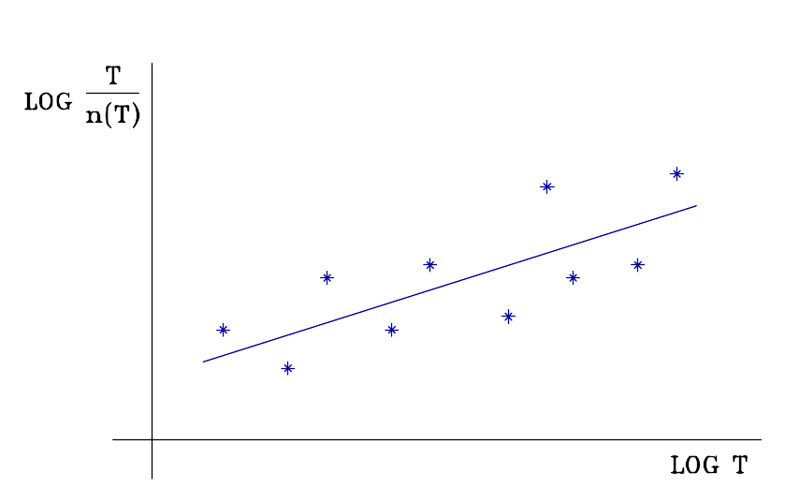
Duane Growth Model
n(T) = accumulated failures
through time T.
T/n(T) is the
cumulative MTTF.
T = total test time
n(T)/T is the cumulative
failure rate
Chapter 14
Notes:
One of the first growth models was proposed by an engineer with the General Electric, J. T. Duane. Duane observed that the log of the cumulative MTTF or failure rate and the log of the cumulative test time were approximately linear.

Slide 5
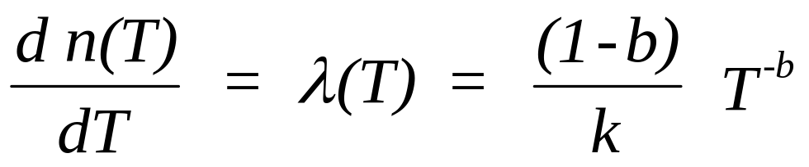
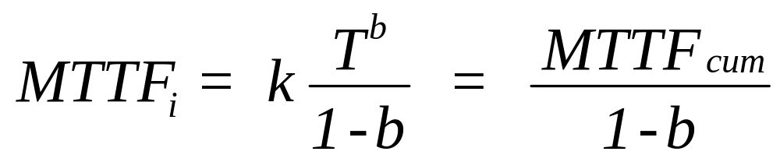
Duane Growth Model
ln[T/n(T)] = a + b ln T
MTTF_{c} = T/n(T) = e^{a+b ln T} = eªT^{b} = kT^{b}
n(T) = (1/k) x T^{1-b}
Chapter 14
Notes:
From Duane’s observation, an empirical model is derived. This model assumes a CFR during a test-fix cycle. However, the failure rate is assumed to then decrease as a result of a redesign. The model attempts to capture this rate of decrease (or increase in the MTTF) as more test time is accumulated. Test time is used because of the observed correlation between the amount of testing and the MTTF. It is also true as well, that as test hours increase so does the number of failures. Therefore, as additional failure modes are observed and identified, more failure modes can be eliminated.

Slide 6
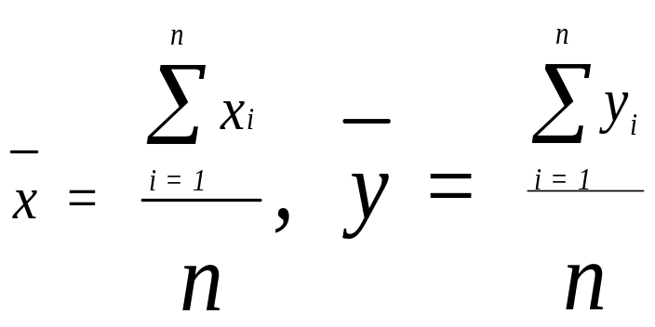
Least-Squares Curve Fit
let
x_{i} = ln (t_{i} ) , y_{i} = ln[t_{i}/n(t_{i})];
and
Chapter 14
Notes:
Least-squares is used to estimate the parameters k and b of the Duane model. This is done by fitting a straight line to x and y as defined above.

Slide 7
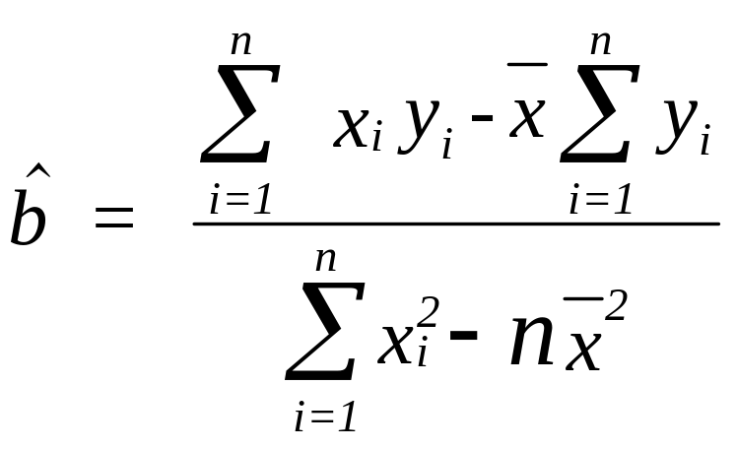
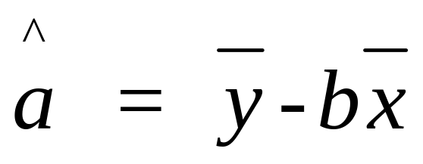
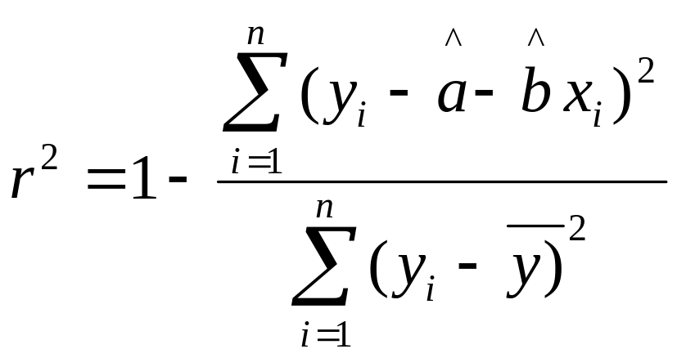
Least-Squares Curve Fit
Then
coefficient of
determination
Chapter 14
Notes:
The above formulae will find estimates for the sloe (b) and intercept (a) of a straight-line that minimizes the sum of the squared deviations. Do you recall the derivation of these formulae from your statistics course?

Slide 8
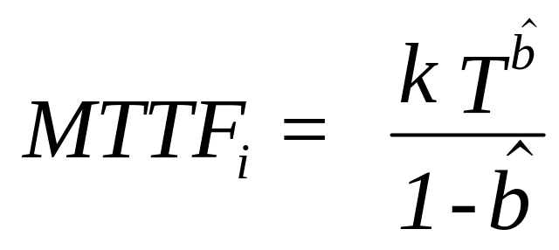
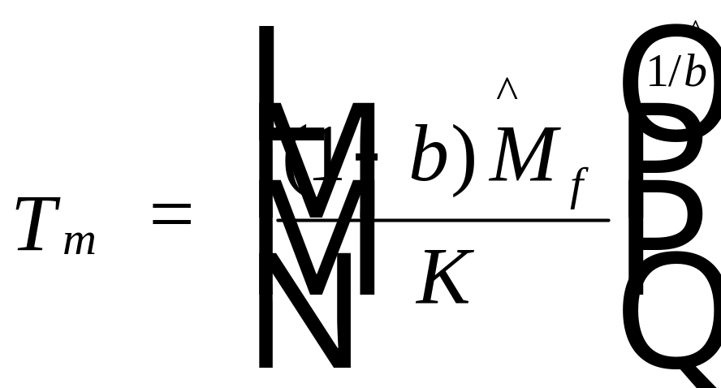
L-S Estimates
k = e^{â}
solve for T
Chapter 14
Notes:
Once “a” is found, then “k” is determined from the above transformation. The instantaneous at time T MTTF is then determined. If the estimated MTTF at the conclusion of the test program, T, does not meet the specification, then more testing must be done. T_{m} estimates the total test time necessary to reach a MTTF goal of M_{f}.

Slide 9
Example 14.2
A new product still in the development stage undergoes reliability
growth testing. Each test-fix cycle consists of 50 hours of testing
with the following failures per cycle observed in order:
24, 17, 9, 5, 3, 2, 1.
Estimate the current MTTF and the additional
test time required to obtain an MTTF goal of 20 hours.
Chapter 14
Notes:
Example data for fitting the Duane model.

Slide 10
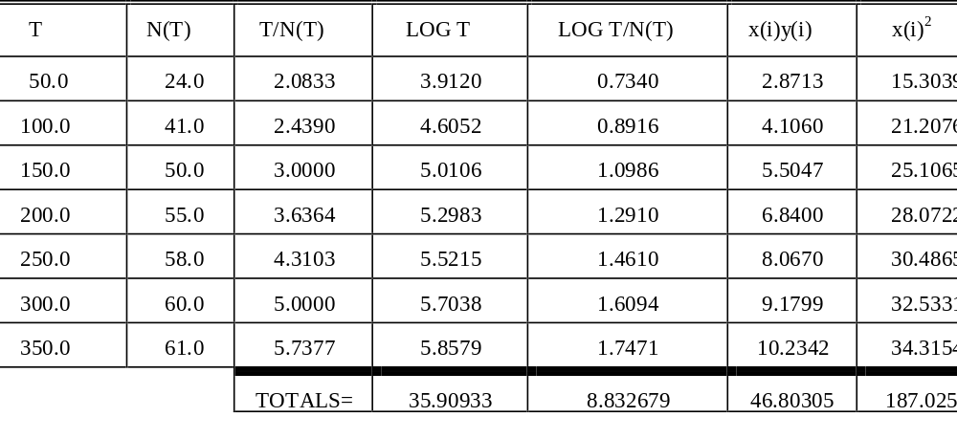
Example 14.2
Chapter 14
Notes:
The least-square estimates can be found using a spreadsheet type calculation or the course software may be utilized. Use the course software to solve this same problem.

Slide 11
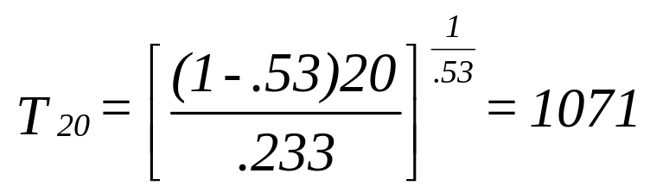
Example 14.2
xbar = 5.1299 and ybar = 1.261811
b = [46.803 - 5.1299 (8.832679)] / [187.0252-7(5.1299)² = .53,
a = 1.261811 - .53 (5.1299) = -1.457
therefore K = e^{-1.457} = .233 .
MTTF_{c} = .233 (350)^{.53} = 5.196
MTTF_{i} = 5.196/(1-.53) = 11.0.
r = .97
1071 - 350 = 721 additional hr.
Chapter 14
Notes:
The results from applying the Duane model after 350 hours of testing. If a MTTF goal of 20 is desired, then 721 additional test hours will need to be generated.

Slide 12
More about the Duane Model
The Duane model has been used throughout the1960s and 1970s.
It models reliability growth well enough to predict the future reliability
It is strictly an empirical model
Provides no insight into the cause of any growth (or deterioration)
It assumes that having a reliability growth program will result in a growth curve that is log-linear
Chapter 14

Slide 13
Along Came Crow
L. H. Crow derived the maximum likelihood estimates to the Duane model
  "Reliability Analysis for Complex, Repairable Systems" (1974),
This provided for statistical analysis such as hypothesis testing and confidence interval estimation.
This statistical based parameterization is referred to as the AMSAA (N.H.P.P.) model
The AMSAA model is also the power-law process model
Chapter 14

Slide 14
More to do with the AMSAA Model
The AMSAA model has the same mathematical form as the Duane model
  i.e. the cumulative number of failures is linear when plotted on ln-ln scale.
However the AMSAA model is statistically based and the Duane model is empirically based
  The Duane model: failure rate is linear on ln-ln scale.
  The AMSAA model: failure intensity of the underlying non-homogeneous Poisson process (NHPP) is linear on ln-ln scale.
Chapter 14

Slide 15
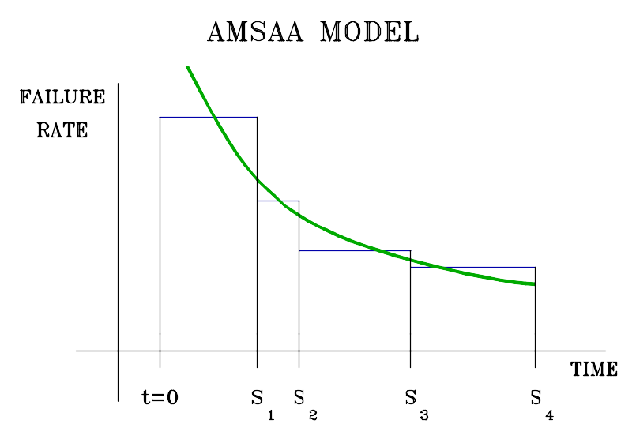
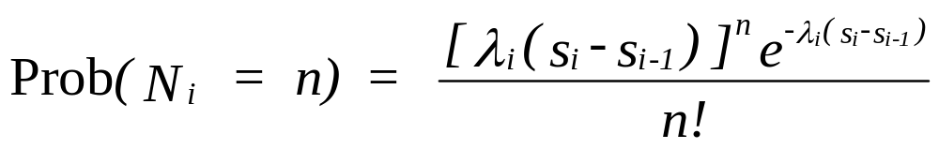

AMSAA Model
Poisson process
mean =
N_{i} = number of failures
during i^{th} test period
Chapter 14
Notes:
The AMSAA model is a theoretically derived model that assumes that failures during the i^{th} test cycle are Poisson generated with a failure rate of λ_{i}. For each subsequent test cycle, it is assumed that the mean decreases. These decreasing failure rates, while occurring as a step function, are approximated by a continuous function.

Slide 16
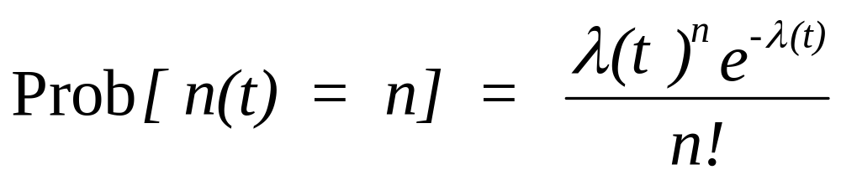
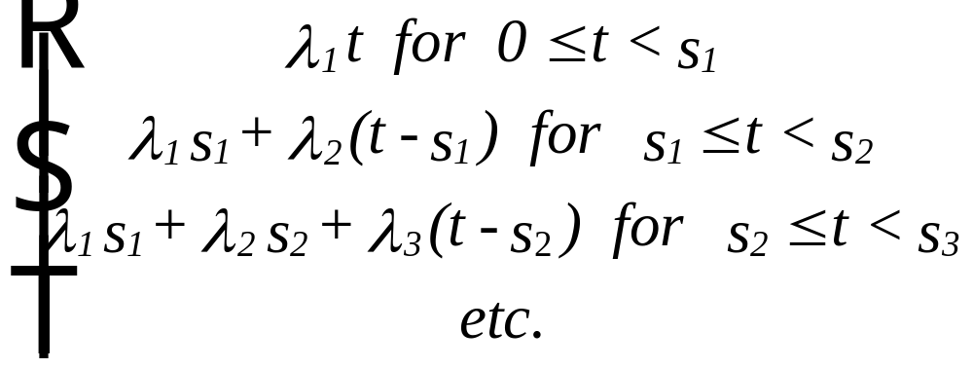
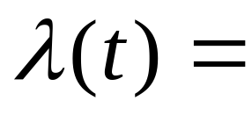
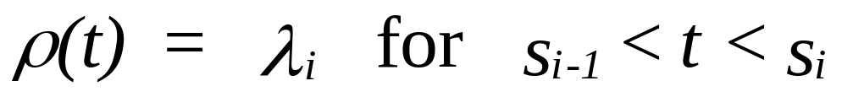
Nonhomogeneous Poisson Process (NHPP)
intensity function:
Chapter 14
Notes:
The failure rate can be expressed as a step function.

Slide 17
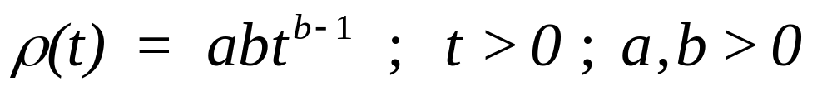
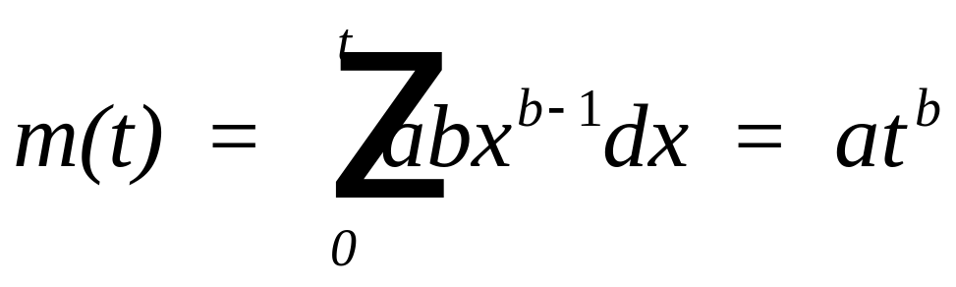
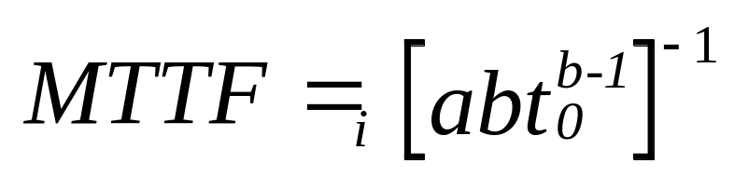
Power Law Process
approximate intensity function with:
expected cumulative number of failures:
Chapter 14
Notes:
The power law process is an approximation to the cumulative failure rate. This is the same function used in Chapter 9 to model minimal repair. The difference now is that the parameter “b” will be less than one if reliability growth occurs. If “b” is greater than one, then the system is deteriorating over time. The expected number of failures can be obtained by integrating the intensity function. The inverse of the intensity function is the instantaneous MTTF.

Slide 18
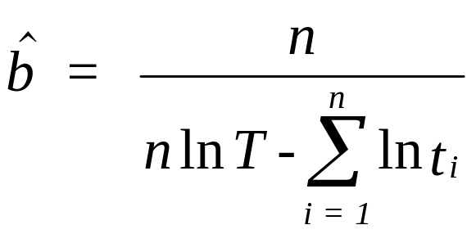
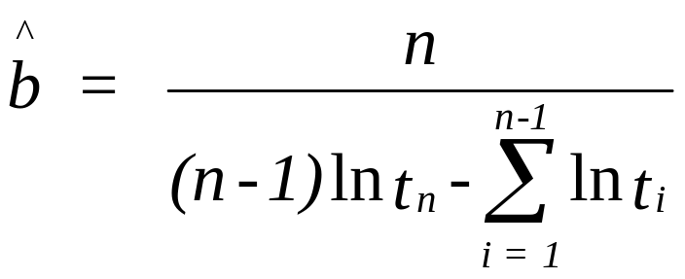
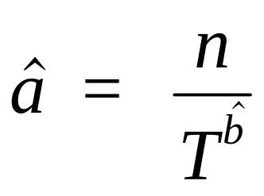
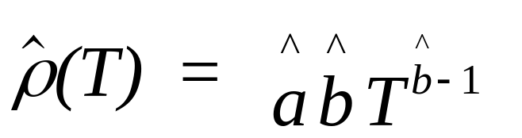
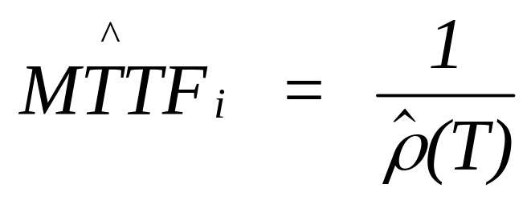
MLE - Parameter Estimation
Type I data:
Type II data:
Chapter 14
Notes:
The formulae given above are for obtaining the maximum likelihood estimators for the parameters “a” and “b.”

Slide 19
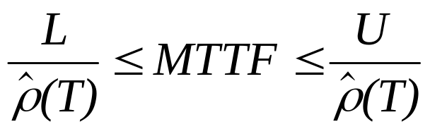
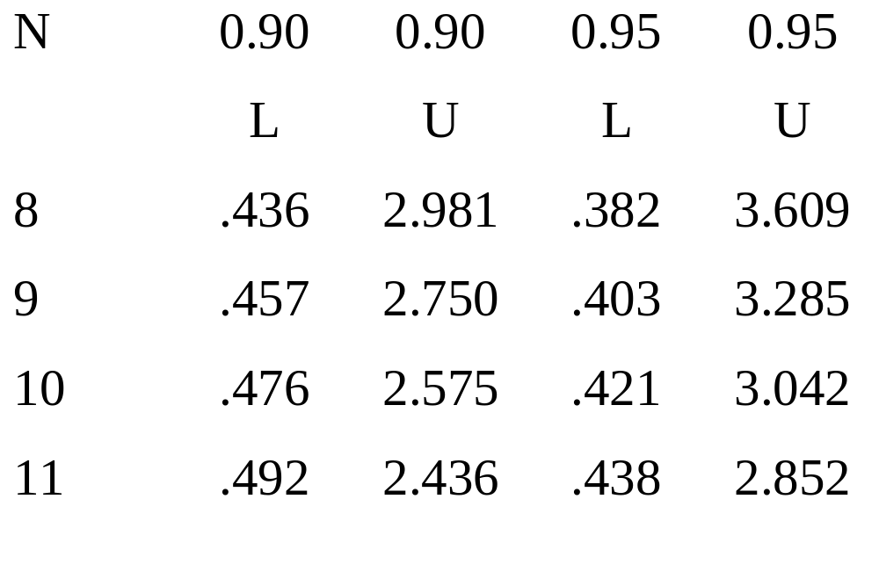
Confidence Intervals
Type I Testing
degree of confidence
sample
size
Chapter 14
Notes:
Confidence intervals for the MTTF can be obtained through the use of tables that provide critical values for selected degrees of confidence and sample sizes.

Slide 20
Example 14.3 - Type I test
Two prototype engines are tested concurrently with Type I testing with T=500 hours. The first engine accumulates a total of 200 hours and the second engine accumulates 300 hours. Times of failures (*) on each engine are identified below:
Engine #1 Engine #2 Cumulative
hours hours hours
5.6* 0 5.6
10.2 8.6* 18.8
20.4* 18.1 38.5
41.8* 36.0 77.8
72.3 61.5* 133.8
88.5* 75.0 163.5
120.0* 105.4 225.4
170.7 152.8* 323.5
190.2 181.3* 371.5
200.0 256.6* 456.6
200.0 300.0 500.0
Chapter 14
Notes:
An example using Type I data. The t_{i} value used in finding the MLEs is the cumulative (total) test time corresponding to the i^{th} failure.

Slide 21
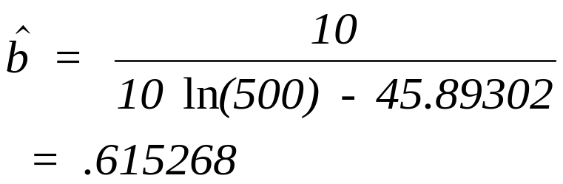
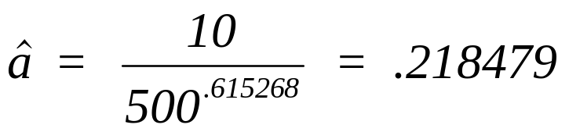
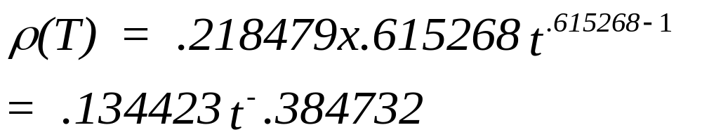
Example 14.3 - Type I test
Failure Time (natural )Log Failure Time
5.6 1.722767
18.8 2.933857
38.5 3.650658
77.8 4.354141
133.8 4.896346
163.5 5.096813
225.4 5.417876
323.5 5.779199
371.5 5.917549
456.6 6.123808
total 45.89302
solution:
Chapter 14
Notes:
The steps in the calculation are shown. Exercise the course software to see if you obtained the results.

Slide 22
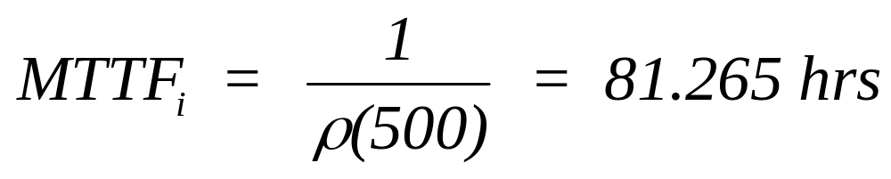
Example 14.3 - Type I test
at the conclusion of the testing:
solution:
A 90 percent confidence interval for the MTTF:
(.476 x 81.26, 2.575 x 81.26) = (38.68, 209.24)
Chapter 14
Notes:
Check the statistical table to see if the correct critical values are being used to generate the above confidence interval.

Slide 23
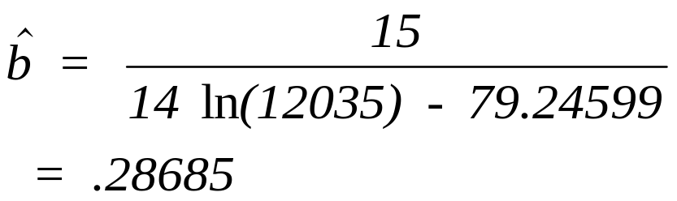
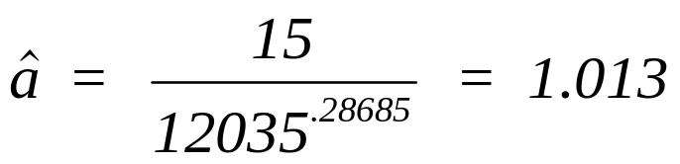
Example 14.4 - Type II test
Failure Time (natural) Log Failure Time
3 1.098612
15 2.70805
35 3.555348
58 4.060443
113 4.727388
187 5.231109
225 5.4161
465 6.142038
732 6.595781
1123 7.023759
1587 7.369601
2166 7.680638
5423 8.598404
8423 9.038721
Total 79.24599
Estimate the AMSAA parameters from
the following failure times:
(test terminated after 15 failures.
Chapter 14
Notes:
The analysis is repeated with Type II data. Failure times are cumulative time on test with the test stopped at the 15th failure.

Slide 24
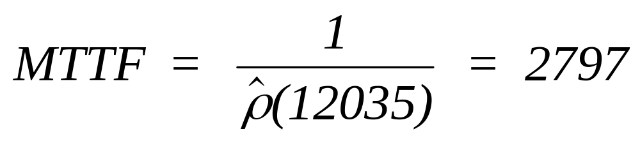
Example 14.4 - Type II test
A 90% confidence interval for the MTTF is given by:
(.6299 x 2797, 2.182 x 2797) = (1762, 6103)
Chapter 14
Notes:
Again, exercise the course software with the data from this example.

Slide 25
Example 14.4
Estimated MTTF_{i} at the conclusion of the test program (25,000 cumulative hours):
MTTF_{i} = [ .29058 (25,000)^{-.71315} ]⁻¹ = 4,711
Total test hrs to reach goal (5,000 hr.):
t = [ (5,000 x .29058)⁻¹ ]^{-1/ .71315} = 27,176
Additional test hrs required = 27,176 – 25,000 = 2176.
Chapter 14
Notes:
Applying the AMSAA model to the test failure data resulted in the intensity function shown above. The statistical tests support the use of the AMSAA model. The estimated MTTF if testing continues for 150,000 cycles is 5200 – still short of the goal. To reach the goal, another 1,672,757 cycles of testing would need to be completed.

Slide 26
Another Example - Machine Failures under Minimal Repair
A drill press manufactured by the
Kanot Faile Company and costing
$ 1200 has experienced minimal
repairable failures on the following
days since it was first installed 2 1/4
years ago (820 days):
150 280 378 490 552 601 641
690 726 770 790
Chapter 14
Animated
Notes:
This example illustrates the use of the AMSAA model methodology for generating the parameters of the power law process model under minimal repair.

Slide 27

Management Displeasure
Management is displeased with the recent
increase in the number of failures. It cost them $160 a failure for labor and parts. Should it be replaced?
A company manager upon
receipt of the most recent
machine reliability report.
Chapter 14
Notes:
An expensive piece of equipment has experienced poor reliability. What to do?

Slide 28
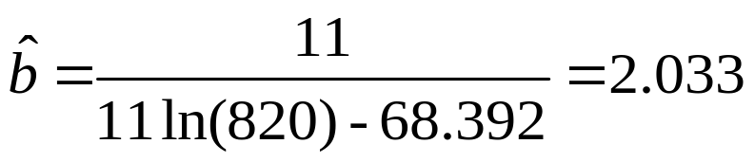
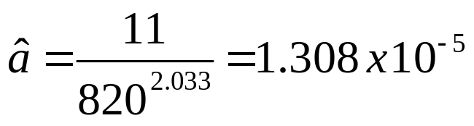
Machine Failures
Power Law Intensity Function
AMSAA Reliability Growth Model & Power Law Process (NHPP)
CUM LOG CUM
FAILURE TIME FAILURE TIME
150 5.010635
280 5.634789
378 5.934894
490 6.194406
552 6.313548
601 6.398595
641 6.463029
690 6.536692
726 6.58755
770 6.64639
790 6.672033
TOTAL 68.39256
(Nbr data pts) N = 11
LOG T OR LOG T(N) = 6.709304
Chapter 14
Notes:
First, an appropriate model is determined from the data that had been collected. under a minimal repair maintenance concept, the power law process is assumed.

Slide 29
Analysis of the situation
1. Current (instantaneous) MTBF = 36 2/3 days
2. Since b = 2.03 > 1, drill is deteriorating
3. The expected number of failures over the next 6 months
(days 820 - 1000) is:
Time Cum nbr failures MTBF Reliability
820 11.0 36.6 inst 1.647E-05
1000 16.5 29.8 inst 6.900E-08
Interval 5.5 32.9 cum .0042 (no failures)
90% CI: 18.0 < MTBF_{I} < 89.3
Chapter 14
Notes:
From the power law process model, it can be seen that the drill deteriorates over time.

Slide 30
Replacement & PM Model
 | Power law process
 | unit of time: | oper hr
 | a = | 0.00001308
 | b = | 2.033
 | replacement cost Cu = | $1,200
 | cost of a failure Cf = | $160
 | cost of a PM = | $85
 | time to replace = | 669.2 | oper hr
min cost per | oper hr | $3.53
 | time between PM = | 182.0 | oper hr
min cost per | oper hr | $0.92
Chapter 14
Notes:
A cost analysis is conducted to determine when to replace the drill. It should have already been replaced based upon the economics.

Slide 31
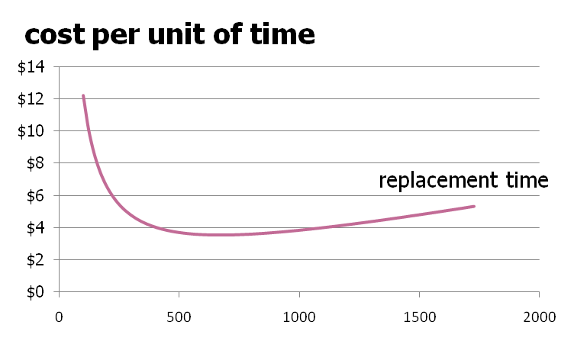
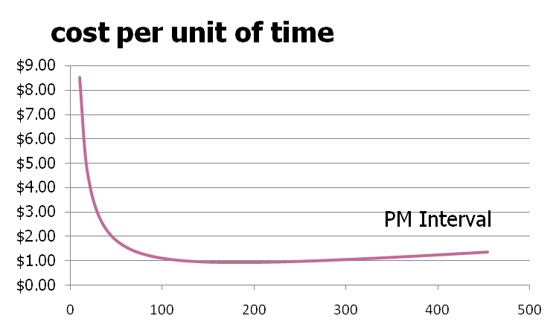
Graphical Analysis
Chapter 14
Notes:
However, Pree Vent, the chief reliability engineer on the program, has determined that a preventive maintenance program that restores the drill to “as good as new” condition is the way to go.

Slide 32
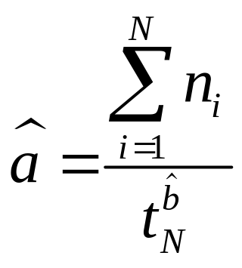
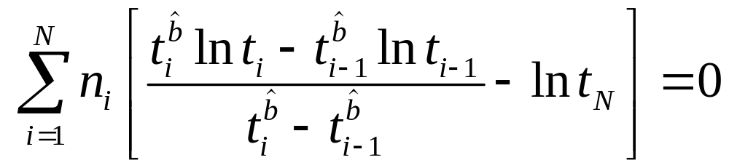

Parameter Estimation with Grouped Data
Let n_{i} be the number of failures that occurred in the interval (t_{i-1} , t_{i}) where t_{i} is the accumulated test time at the end of the i^{th} test cycle, i = 1,…,N. Assuming a NHPP with the power law intensity function ρ(t) = abt^{b-1} , the maximum likelihood estimates are found from:
solve numerically for
Chapter 14

Slide 33

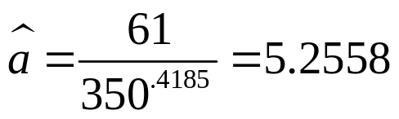
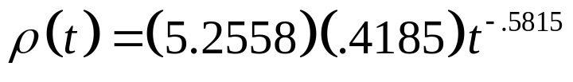
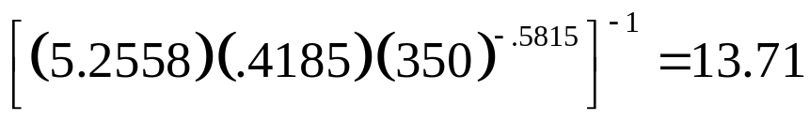
Example 14.5
Using the data in Example 14.2, Eq. (14.27) was solved numerically
for
thereby giving
The intensity function is
The instantaneous MTBF at the end of the last test cycle is
Compared to the estimated MTTF_{i} from the Duane model of 11.0.
Chapter 14

Slide 34
Chapter 14
Reliability Growth Testing
Reliability Growth Process
Duane Growth Model
AMSAA Model
Chapter 14
Notes:
Reliability growth testing has as its objective improved reliability. The growth testing process as well as two of the more popular models for tracking reliability growth over time are discussed.

